Slide 1

G2M Case Study
Virtual Internship
28-Aug-2021
Done by : Raghad Almeataz

Slide 2
Problem Statement –G2M(cab industry) case study
Problem:
XYZ is a private firm in US. Due to remarkable growth in the Cab Industry in last few years and multiple key players in the market, it is planning for an investment in Cab industry and as per their Go-to-Market(G2M) strategy they want to understand the market before taking final decision.
Objective :
Identify which cab is more profitable to XYZ Company if they invested in through creating actionable insights.

Slide 3
Dataset Overview
The dataset is a combination of 4 datasets, which collectively contains 18 features and 359392 rows.
4 of 18 features are derived from existing columns.
The dataset contains information about transaction charges, costumer demographics and the cities that the Cabs operates in.

Slide 4
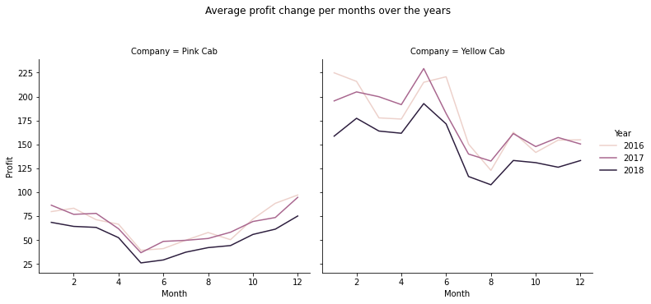
Profit Analysis
Profit Change Over Years
Yellow cab generated more revenue than Pink Cab considering the number of transactions for each.
Both cabs generate less in year 2018.
In Yellow Cab, we can see a noticeable peak in May and June in all years, which indicate and increased demand.
In Pink Cab, we can see there is loss in profit from January to May. Then the profit keeps increasing.

Slide 5
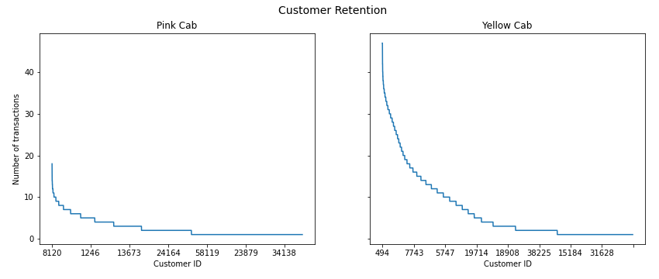
Customer Retention
There highest number of transactions by a single customer in Yellow Cab is more than 40 while in Pink Cab is less than 20 transactions.

Slide 6
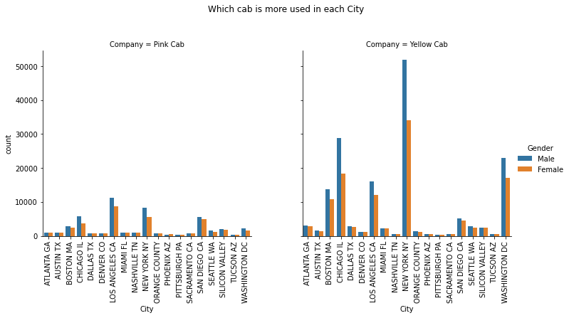
Which cab is more used in each City?
Males use the cabs more than women in all cities.
Yellow Cab is popular in New York, Chicago, Washington DC, Los Angeles and Boston respectively.
Pink Cab is popular in Los Angeles, New York, San Diego, Chicago and Boston respectively.
Yellow cab is used approximately 5X more than Pink Cab by both genders.

Slide 7
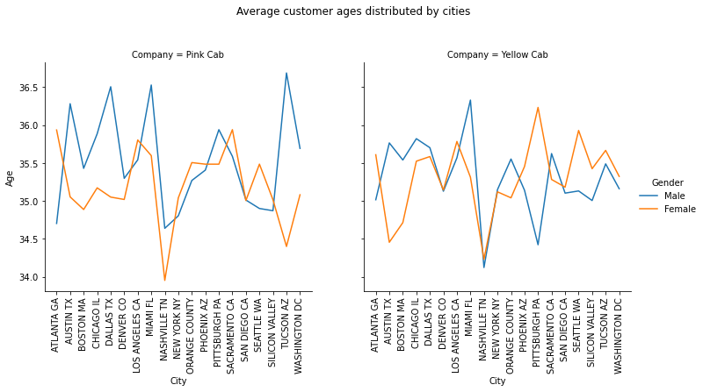
Customer Demographics distributed by City 1
The minimum – maximum ages of customers are (18-65).
The average age of customers of both cabs is (34-37).

Slide 8
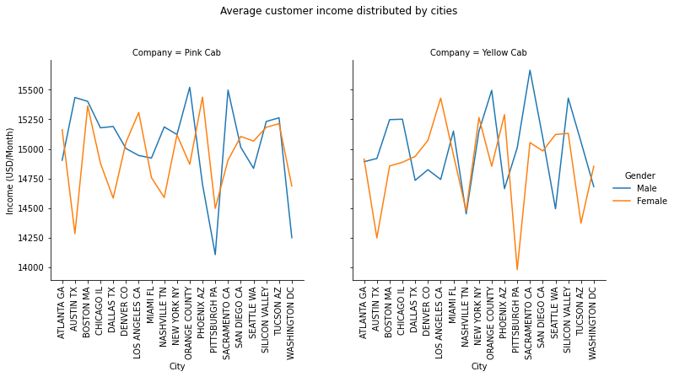
Customer Demographics distributed by City 2
The minimum – maximum Income of customers are (2000-35000).
The average income of customers of both cabs is (14000-15500).

Slide 9
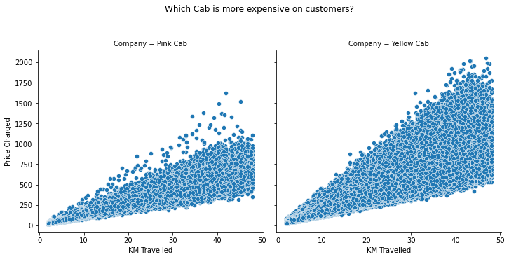
Which Cab is more expensive on customers?
There is a positive relationship between KM travelled and Price charged.
Yellow Cab has generated higher charges at 50KM than Pink Cab.

Slide 10
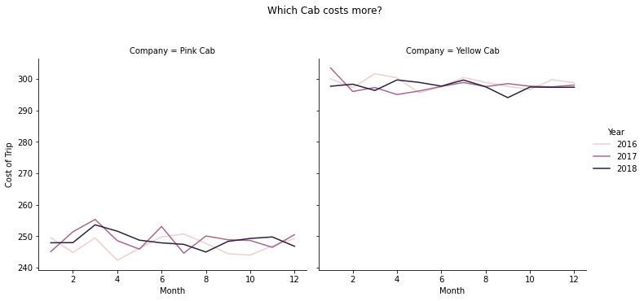
Which Cab costs more?
Average spending of Yellow Cab is between 290 to 300.
Average spending of Pink Cab is between 240 to 260.

Slide 11
Conclusion
Results:
Yellow cab generated more revenue than Pink Cab considering the number of transactions for each and both generated less in year 2018.
In Yellow Cab, we can see a noticeable peak in May and June in all years, which indicate and increased demand.
In Pink Cab, we can see there is loss in profit from January to May. Then the profit keeps increasing.
There highest number of transactions by a single customer in Yellow Cab is more than 40 while in Pink Cab is less than 20 transactions.
Males use the cabs more than women in all cities.
Yellow Cab is popular in New York, Chicago, Washington DC, Los Angeles and Boston respectively while in Pink Cab is popular in Los Angeles, New York, San Diego, Chicago and Boston respectively.
Yellow cab is used approximately 5X more than Pink Cab by both genders.
There is a positive relationship between KM travelled and Price charged.
Yellow Cab has generated higher charges at 50KM than Pink Cab.
Average spending of Yellow Cab is between 290 to 300 while average spending of Pink Cab is between 240 to 260.
Recommendations:
Based on results, despite the high spent charges, it is recommended to invest in Yellow Cab since it has 5X more Customers than Pink Cab and it generates almost double profit than Pink Cab. In addition, it operates on high population cities with high income customers.

Slide 12
Thank You

